Slide 1


Introduction to Python
By hank bot

Slide 2
Let’s question ourselves here: Why python?
Strengths | Weaknesses
Interactive | Weak in Mobile Computing
Object-oriented | Slow
Portable | Run-time Errors
High-level | Underdeveloped Database Access Layers
Extensible in C++ & C | Difficulty in Using Other Languages

Slide 3
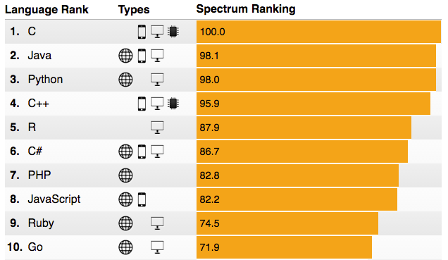
Just to spice things up between developers…

Slide 4
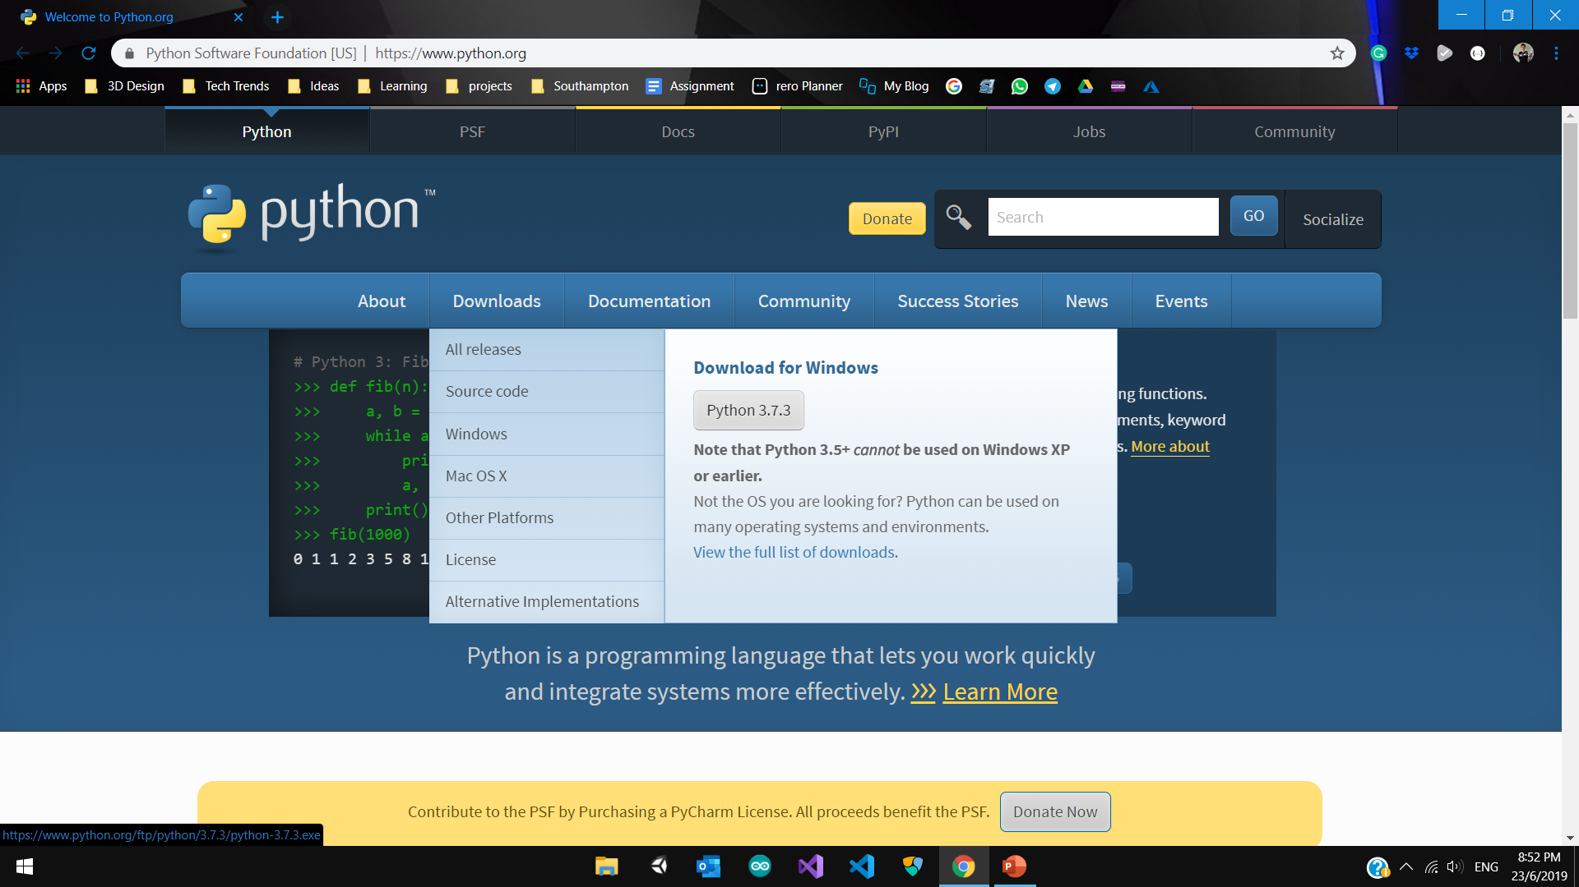
Let’s get started!
Go to python’s official page
to download their installer,
this should take only
a few minutes. Mac users probably have
python already on their laptop.

Slide 5
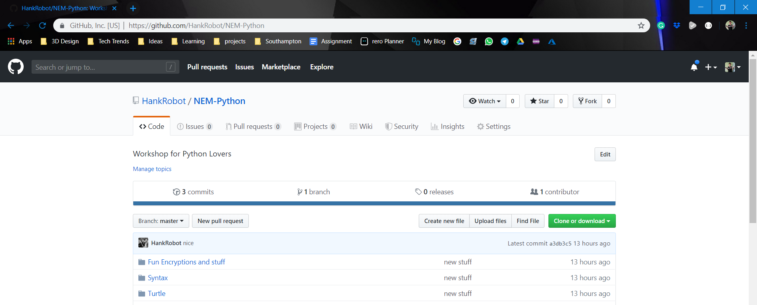
GitHub Code
Check telegram for the link or go to https://github.com/HankRobot/NEM-Python

